Slide 1
excel Project
This dataset is based on Sales of mobiles. It contains 701 mobiles.
This dataset consist of 20 columns & 701 rows.
From this dataset, the fields which are used as follows :
Segment, Mobile Name, User Rating, Reviews, Price, Year, State, etc.

Slide 2
PROBLEM STATEMENTS
WHICH SEGMENT HAVE HIGHEST SALES AND PROFIT?
WHAT ARE THE TOP 10 PRODUCTS WITH HIGHEST USER RATINGS & REVIEWS?
WHICH MOBILE PHONES HAVE HIGHEST MANUFACTURING PRIZE?
WHICH STATE HAVE HIGHEST SALES AND PROFIT?
WHAT IS THE OVERALL PROFIT ?(IN PERCENTAGE)
HOW MANY UNITS SOLD PER MONTH?
WHAT IS THE PRODUCTS MANUFACTURING PRIZE BASED ON RAM?

Slide 3
SEGMENT WISE SALES & PROFIT

Slide 4
PRODUCTS USER RATING AND REVIEWS

Slide 5
PRODUCTS MANUFACTURING PRIZE

Slide 6
STATEWISE SALES AND PROFIT

Slide 7
OVERALL PROFIT

Slide 8
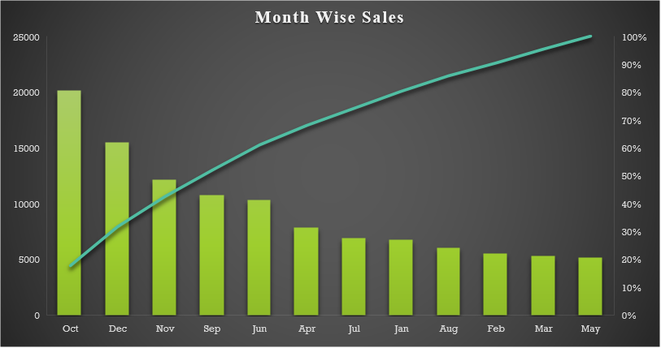
MONTH WISE SALES OF PRODUCT

Slide 9
PRODUCTS PRIZE BASED ON RAM

Slide 10
SOURCE DATA
DATASET LINK
https://www.kaggle.com/ginelledsouza/mobilephone
VIDEO PRESENTATION LINK
https://drive.google.com/file/d/1rNPOH0fNmg3Abpo0Bu52mf3PK8PL_x1i/view?usp=sharing

Slide 11
CONCLUSION
SHOPPING MALL HAS HIGHEST SALES AND PROFIT
REAL ME 6 HAS HIGHEST USER RATINGS AND REVIEWS
KECHAODA 115 HAS HIGHEST MANUFACTURING PRIZE
UTTAR PRADESH HAVE HIGHEST SALES AND PROFIT
OVERALL PROFIT IS 63%
IN MONTH OF OCTOBER HIGHEST PRODUCTS SOLD
PHONES WHICH HAVE 64 GB RAM HAS HIGHEST MANUFACTURING PRIZE

Slide 12
DASHBOARD

Slide 13
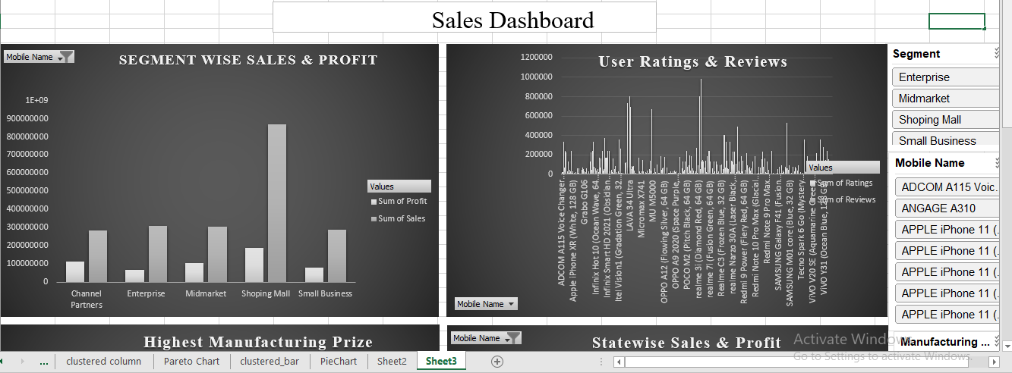

Slide 14
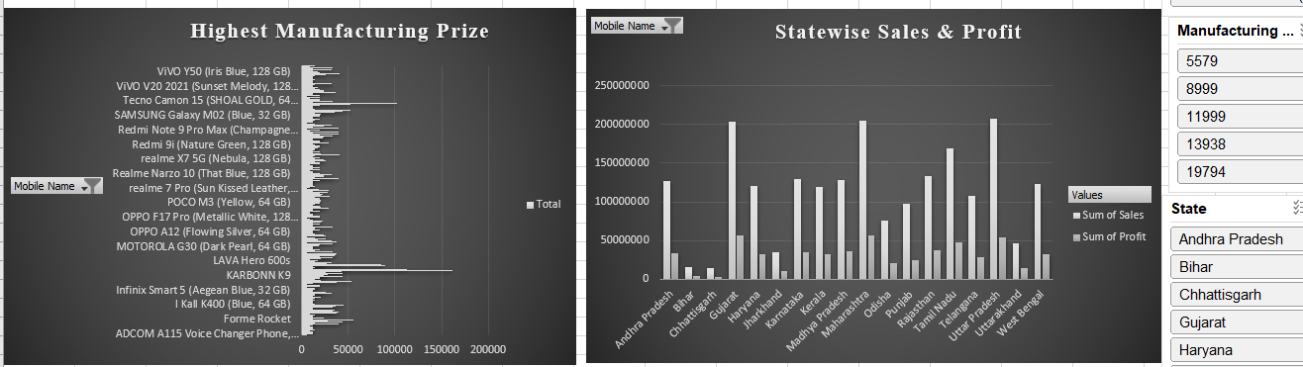

Slide 15
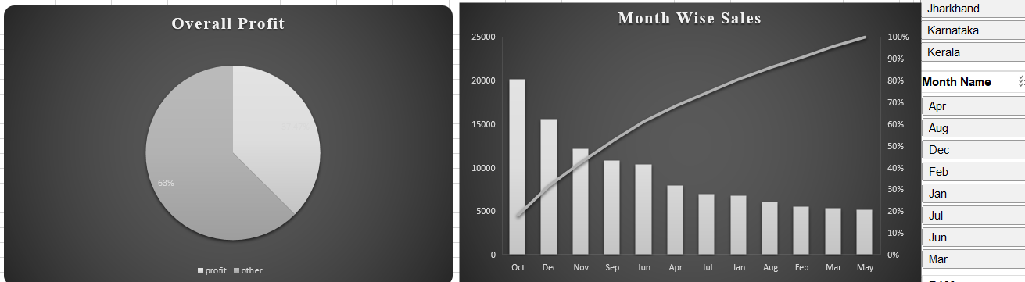

Slide 16
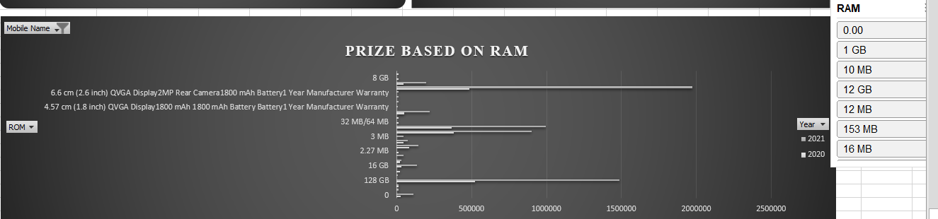

Slide 17
THANK YOU

